Slide 1
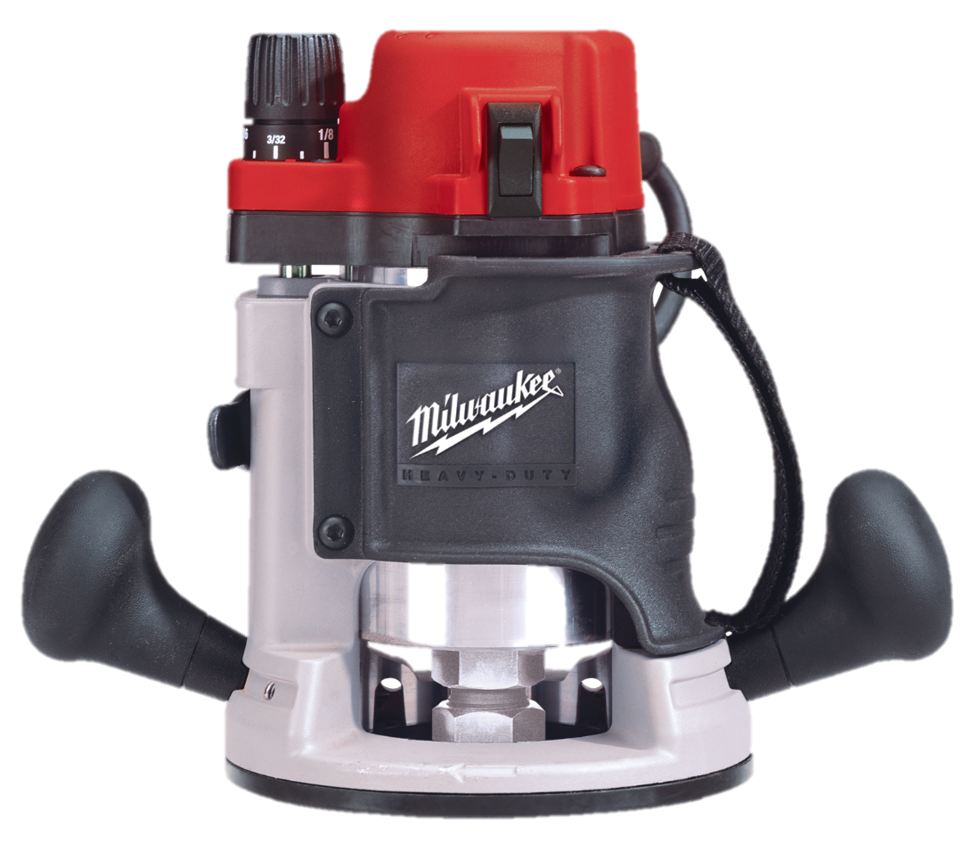
Portable Routers
Notes:
Portable routers are one of the most versatile tools in the shop. They are used for cutting out materials, creating wood joinery, as well as shaping decorative edges. This learning unit will cover the parts and accessories for fixed-base and plunge routers.

Slide 2
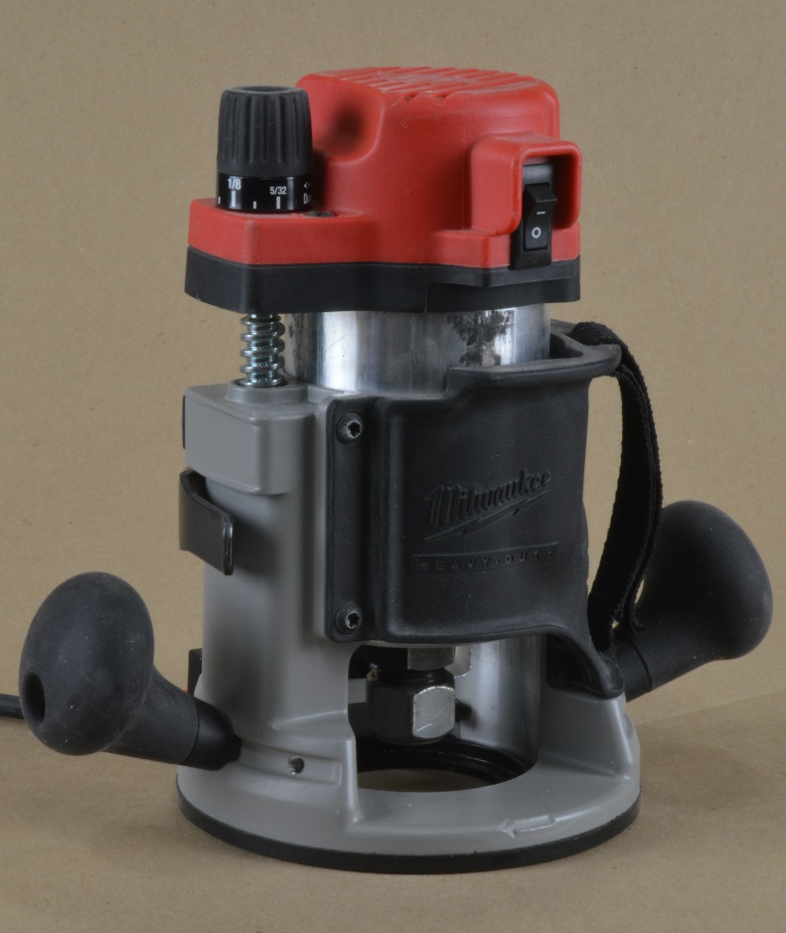
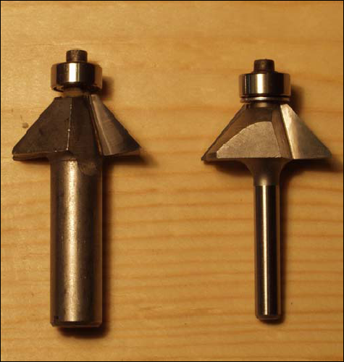
The Router
1/2” Shank 1/4” Shank
Notes:
portable router are fitted with cutters that shape and trim the edges of boards. The bit spins at extremely high rates-of-speed, between 12,000-25,000 rpm. Routers are rated by horsepower (hp) and collet capacity. The router bit shank is held in the router by a collet, which squeezes the shank when you tighten the collet nut. Small routers may have a ¼” collet, while larger routers typically can accept both 1/4” and 1/2” router shanks, by changing collets.

Slide 3
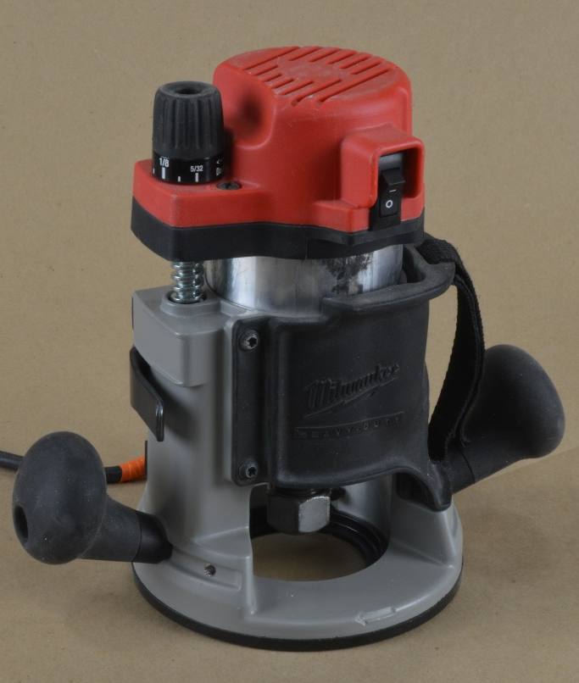
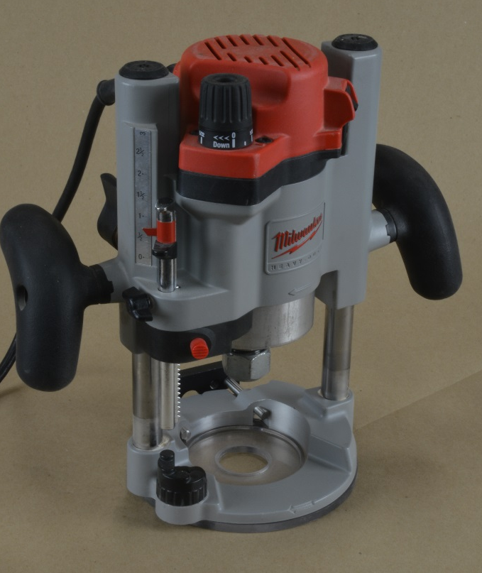
Router Types
1-1/2 hp Router
with a Fixed
Router Base
The Same Router
Motor with a Plunge
Router Base
Notes:
The two (2) most common types of routers are: Fixed-base routers, which have a motor that is adjusted to a pre-set depth-of-cut before the router is turned on; and Plunge routers , which have a motor that slides up-and-down allowing the depth-of-cut to be changed while the router is turned on.

Slide 4
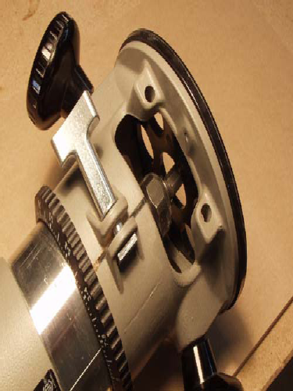
Fixed-base Router Features
Removable Base
Height Adjustment
Lock
Baseplate
Adjusting Ring
Notes:
Common parts of a router include the on/off switch, a removable base with a replaceable baseplate (also known as a “sub-base”), and a nut which tightens the collet, which is what grips the router bit. Unless equipped with a spindle lock, routers typically require the use of two (2) wrenches to loosen and tighten the collet.

Slide 5
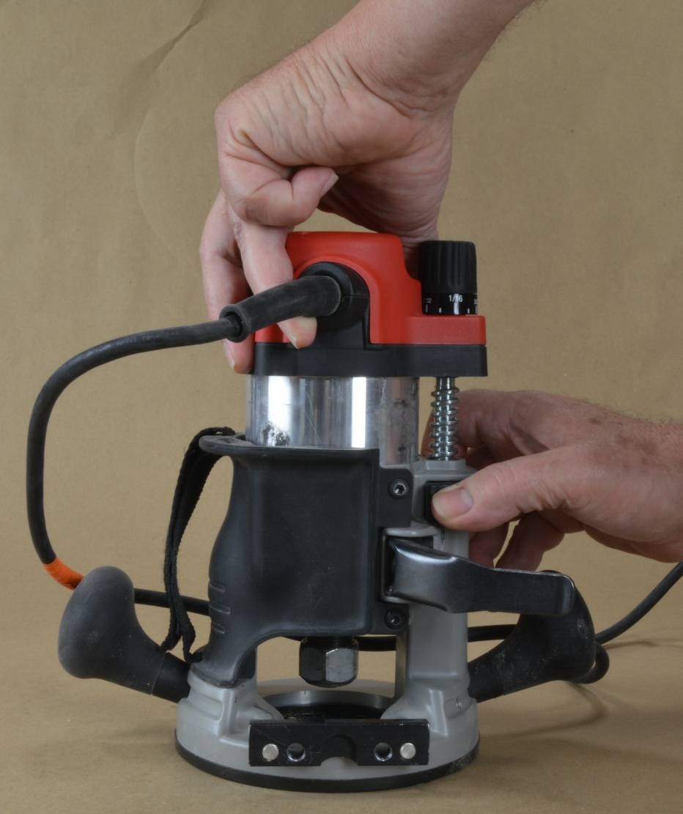
Depth-of-Cut Adjustment
Notes:
The router motor slides up and down inside the base, and has a lock to secure the adjustment. Some routers have a ring or knob that will allow fine tuning of the depth adjustment. Routers must be turned OFF and should be unplugged while making depth adjustments. This router slides in the base when you loosen the locking lever. Height adjustments are made by sliding the motor up or down. Do not attempt to make adjustments without unclamping the motor from the base.

Slide 6
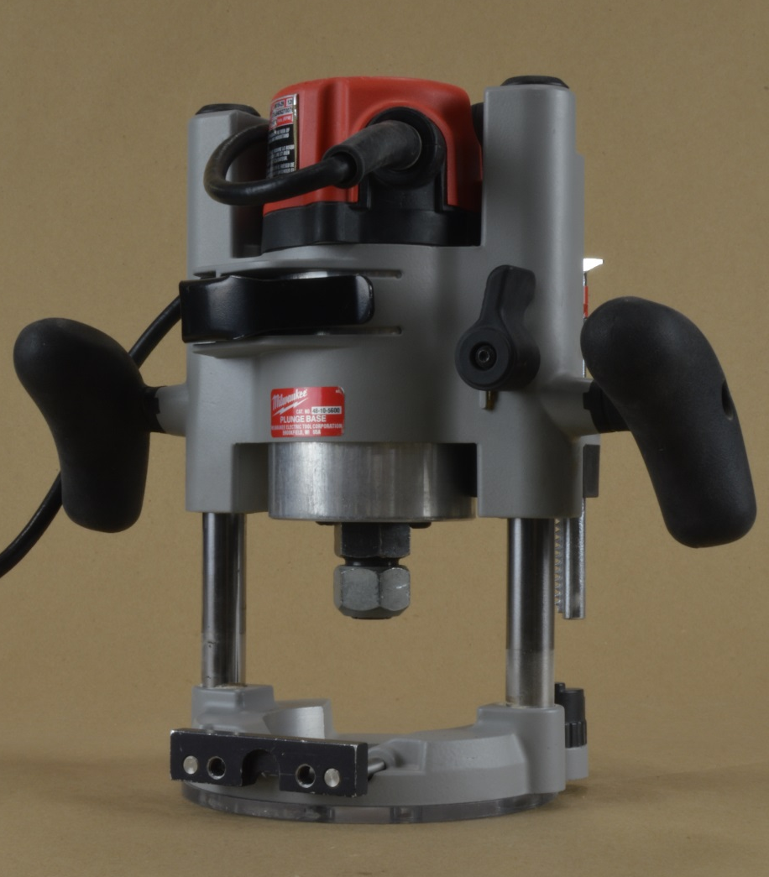
Plunge Routers
The router slides up and down on the two
posts.
Notes:
Plunge router motors slide up-and-down on spring-loaded posts. The router can safely be started above the surface of the work and plunged to pre-set depths. Springs lift the motor when pressure is released. The router motor can be locked at any height on the posts.

Slide 7
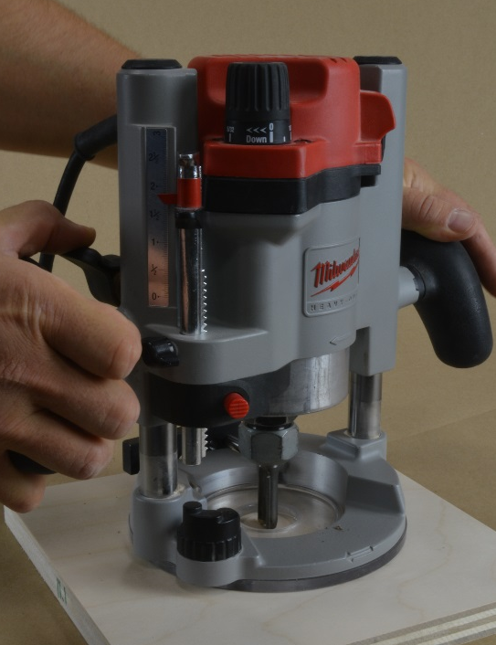
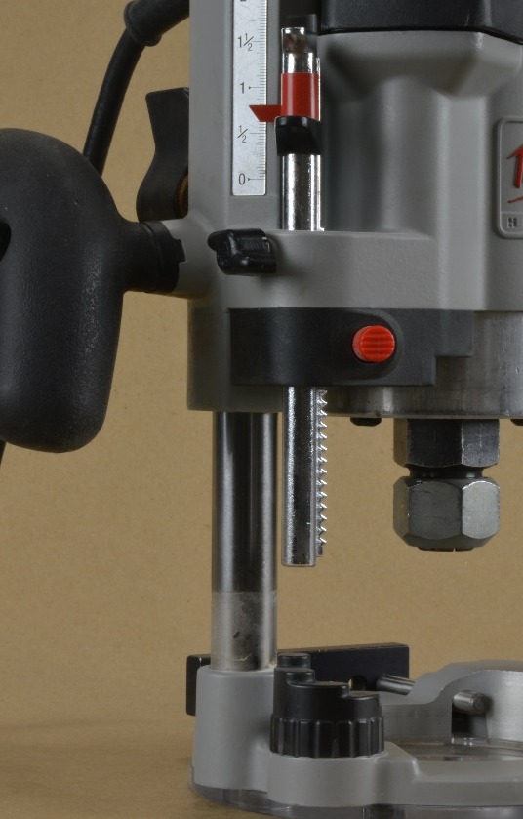
Plunge Router Features
Plunge Lock
Depth-Of-Cut Adjustment
Rod (Depth-Stop)
Turret Stop with Screw Adjustors
Notes:
Plunge routers have similar controls as fixed-base routers: they have an on/off switch, a collet and nut, and a replaceable baseplate. Additional parts include a locking plunge lever, some type of depth of cut adjustment, a turret stop with stops to allow a pre-set a range of cutting depths, and a rod which acts as the depth-stop.

Slide 8
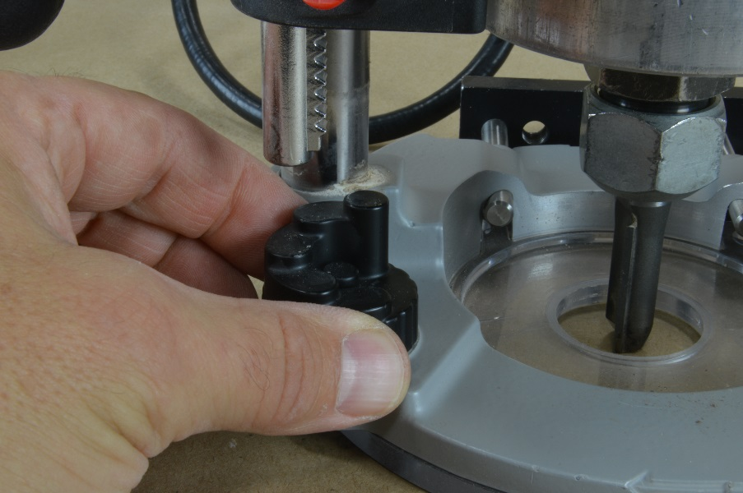
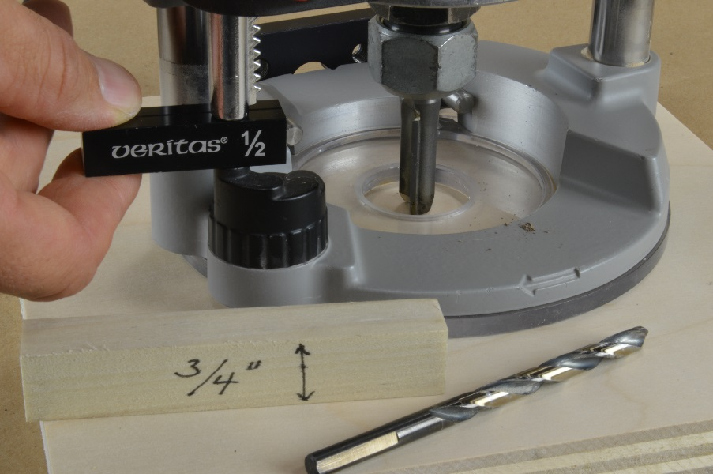
Setting the Depth of Cut
Notes:
Follow these steps to set the depth of cut on a plunge router: With the tool unplugged, gently plunge the bit so that it just touches the surface of the material to be cut. Rotate the turret to its highest position and lower the depth rod to touch the turret. This is known as the zero point. For common depths such as 1/8”, ¼” or ½”, rotate the turret to the corresponding stop. Alternatively, once the router is zeroed out, you could raise the depth rod by the amount you want to plunge. Use a gauge block, piece of wood, or drill bit that is the desired thickness. Remember to raise the bit before making the cut.

Slide 9
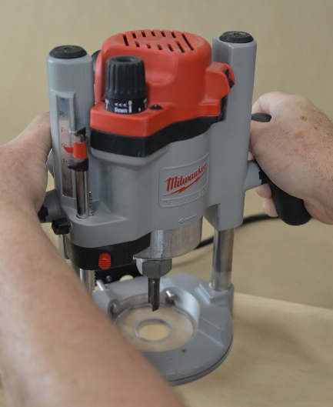
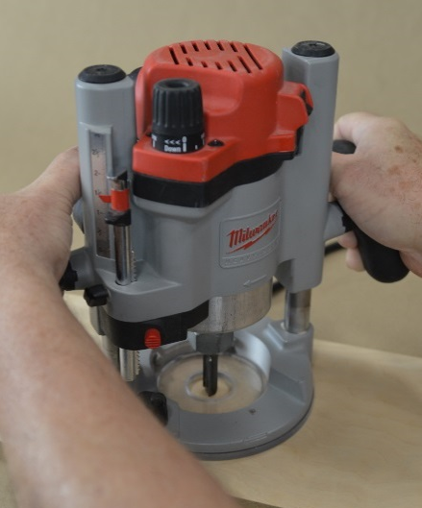
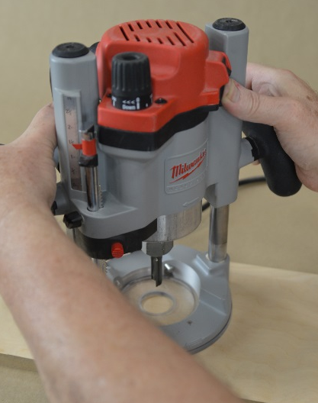
Typical Plunge Router Operation
1. Set plunge depth with the router unplugged. Controls will vary by brand.
2. Rest the router base-plate on a test piece of wood.
3. Switch the router ON (the router bit should not be touching the wood).
4. Release the plunge lock.
5. Plunge into the material to the pre-set depth.
6. Tighten the plunge lock.
7. Complete the cut.
8. Release the plunge lock and raise the router.
9. Switch the router OFF.
Up Position, Turn ON
Down Position, Rout
Up Position, Turn OFF
Notes:
To operate a plunge router, follow the following steps….

Slide 10
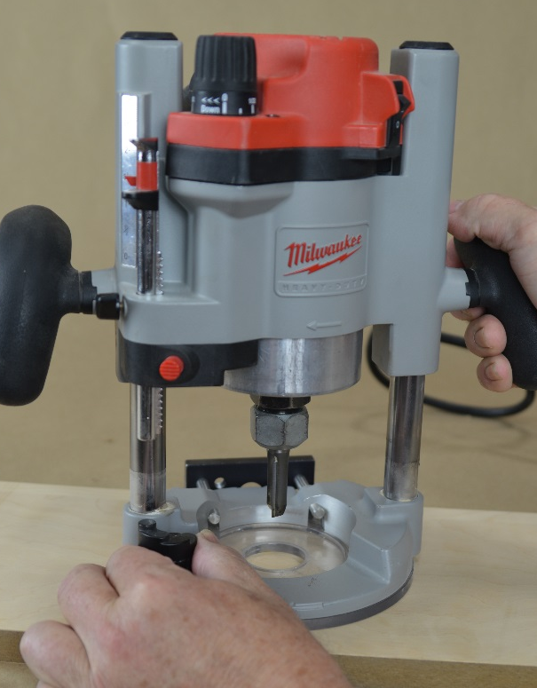
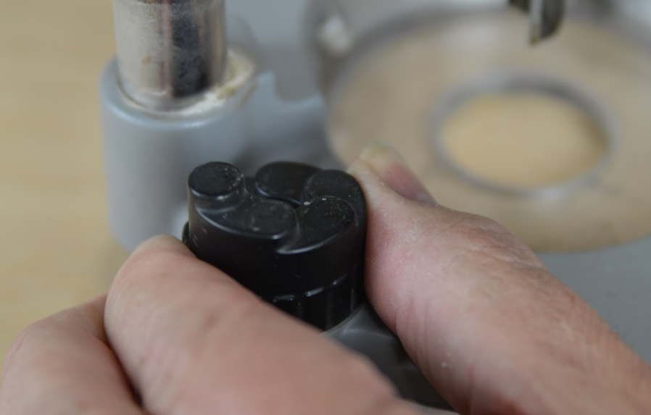
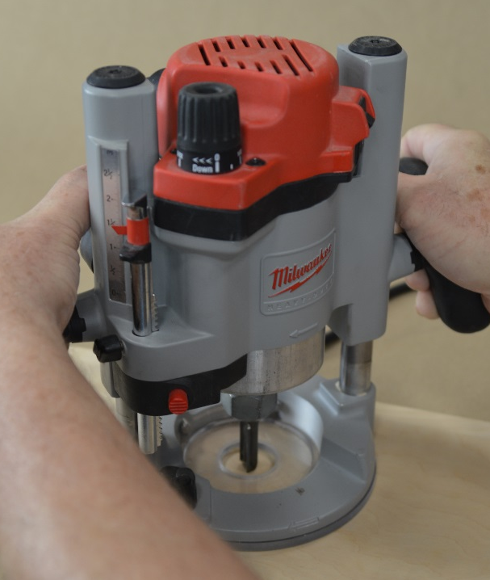
Making Multiple Passes
Notes:
If you need to make a deep cut, make multiple passes at progressive depths. This reduces tearout, burning and bit breakage. Rotate the turret stop each time to make successively deeper cuts.

Slide 11
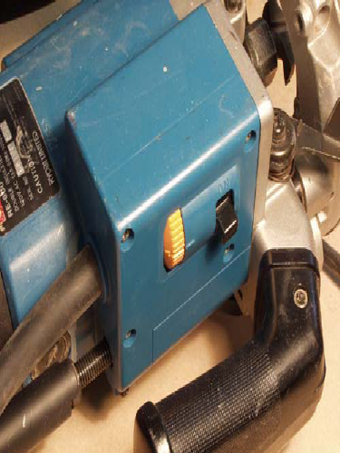
Variable Speed Routers
Bit Size (Diameter) | Max Speed (rpm)
0-1” | 24,000
Up to 2” | 18,000
Up to 2-1/2” | 16,000
Up to 3-1/2" | 12,000
ON-OFF Switch
Variable Speed
Dial
Notes:
Variable Speed routers allow you to adjust the speed of the router bit. This control is usually a rotating dial located on the body of the tool, and is separate from the ON-OFF control. Larger diameter bits should be run at slower speeds, while smaller bits should run at higher speeds. Running a large diameter bit at a high speed is dangerous. Tooling manufacturer’s provide charts with recommended speeds, It is also important to be aware that some woods will burn if a cutter is used at high speed, regardless of how sharp it is.

Slide 12
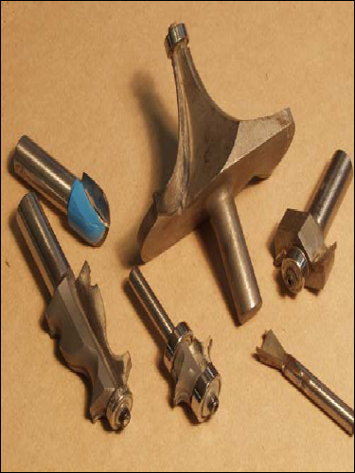
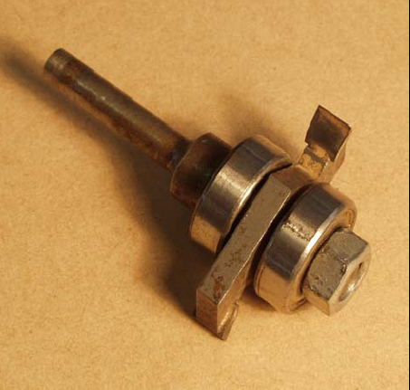
Router Bits

Slide 13
Router Bit Types
Click here to see Router bit types
Notes:
Router bits are the cutters that do the shaping. They come in many shapes and sizes. You need to be able to identify profiles, because bits do not always get put back in the correct place in the cabinet.
Routers bits typically come with either a 1/4” or 1/2” shank. Though slightly more expensive, 1/2” bits are stronger, stiffer and less likely to break. Most production bits have a carbide cutting edge for longer service life. All bits are not created equal. Subtle differences from one company to another in design and quality of materials can produce dramatic differences in performance.

Slide 14
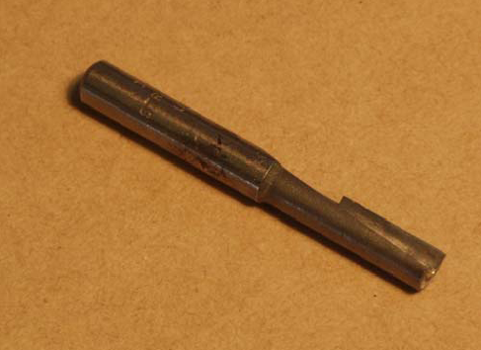
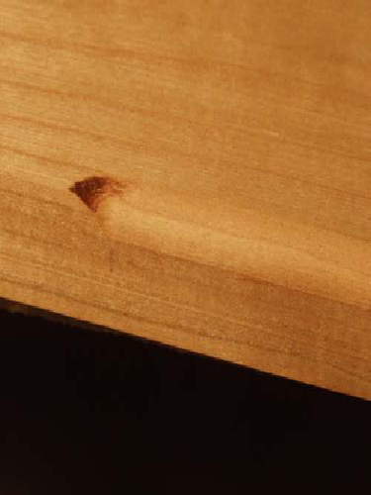
Long, Narrow Bits
Burn Mark from a Dull Bit
Notes:
Long, narrow bits with 1/4” shanks are vulnerable to bending and stress. Be careful when applying pressure to a cut when using this type of bit. These bits can break when applying too much force while routing. A good rule of thumb is to never cut deeper than the diameter of the bit in one pass.
Dull bits will tear and chip the grain, causing burn marks on the work and overload the motor. Heat also builds up when waste chips are not cleared or if the feed-rate is too slow. Bits should be sharpened or replaced when you see burn marks.

Slide 15
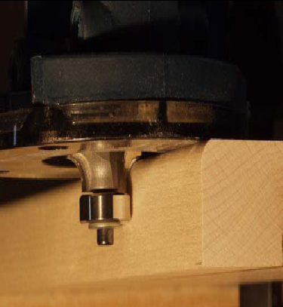
Edge-Forming Bits
Pilot Bearing
Notes:
Edge-forming bits are used to shape and trim the edges of boards. Most have a pilot bearing that rolls along the edge of the work-piece to guide the router and control the cut. The bearing turns freely (which prevents burning the edge from friction), while the bit spins at the router’s speed. Pilot bearings must be kept free of glue, pitch and sawdust.

Slide 16
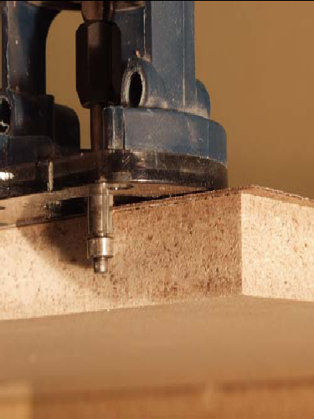
Flush Trim & Pattern Bits
Notes:
Flush-trim bits are commonly used to trim plastic laminate even with the surface that the bearing follows. The pilot bearing is the same diameter as the cutter. Pattern bits are similar to flush trim bits, except that the bearing is mounted at the top of the cutter. Pattern bits are used in conjunction with a pattern to route pre-defined shapes.

Slide 17
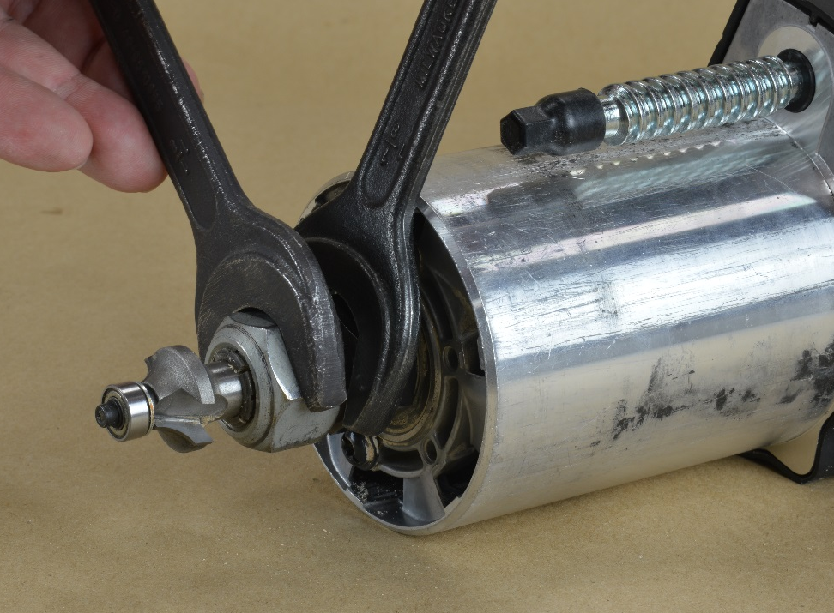
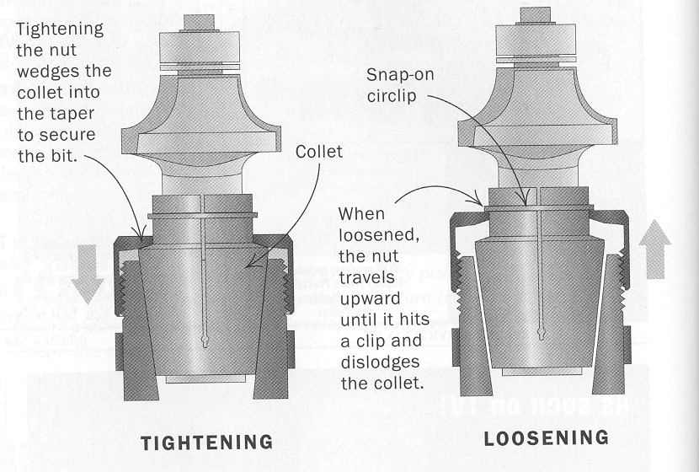
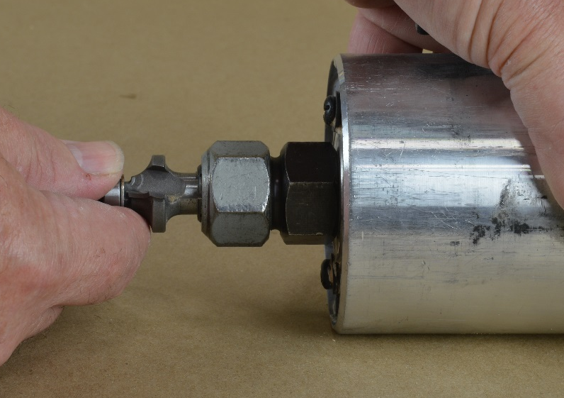
Changing Router Bits
Notes:
Most routers require two wrenches to change the bit. One wrench holds the spindle, while the second wrench loosens or tightens the collet nut. Remove the motor from the base if possible to make access to the bit easier. If the nut is loose and the bit remains tight, continue unscrewing the nut. Many collets have a secondary point which must be reached before the bit is freed.

Slide 18
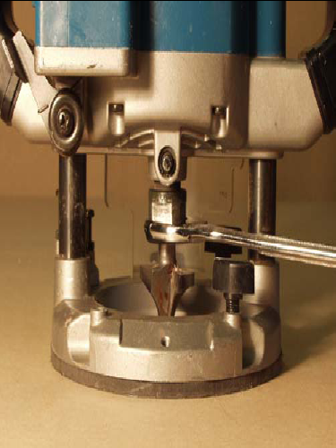
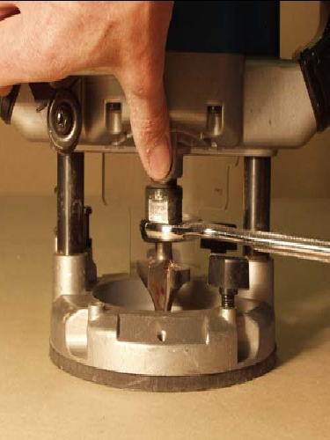
Changing Router Bits, continued
Spindle Lock
Press Spindle Lock to
Loosen Collet with Wrench
Notes:
A spindle lock is a feature that secures the router spindle in place, while you change bits. With one finger you can lock the spindle and use a wrench in the other hand to loosen the collet nut.

Slide 19
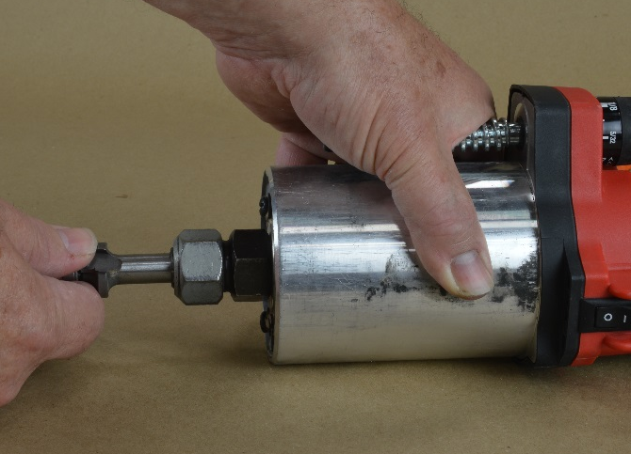
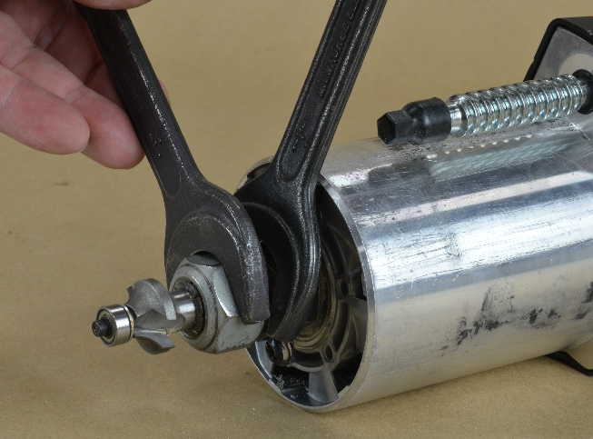
Installing Router Bits
• ALWAYS unplug the router.
• Loosen the collet nut.
• Insert the bit into the bottom of the collet, but do not let the bit “bottom out” against the spindle
(Doing so will prevent the bit from being properly secured). Tighten the nut by hand to hold the bit.
• Finish tightening the collet nut by squeezing the wrenches together.
Gap
1/16” Min.
Notes:
When installing router bits…..

Slide 20
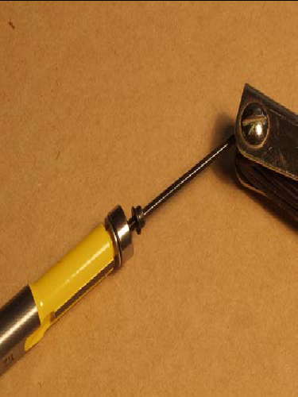
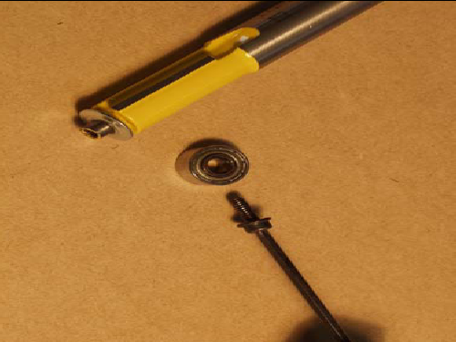
Bit Care
Remove the Screw Clean the Bearing and Lubricate
Notes:
Carbide bits are brittle. Be careful not to drop them as they can break. Pitch build-up is a sign of a dull bit. The bit heats up and draws pitch out of the wood. Sharpen or replace the bit.
Clean and lubricate pilot bearings. Contact adhesive can seize a bearing and unthread the bearing screw. The bearing can fall off and the router bit will dig into your work. Pay close attention to the condition of pilot bearings. Inspect router bit shanks for damage, which may be a sign of a damaged collet.

Slide 21
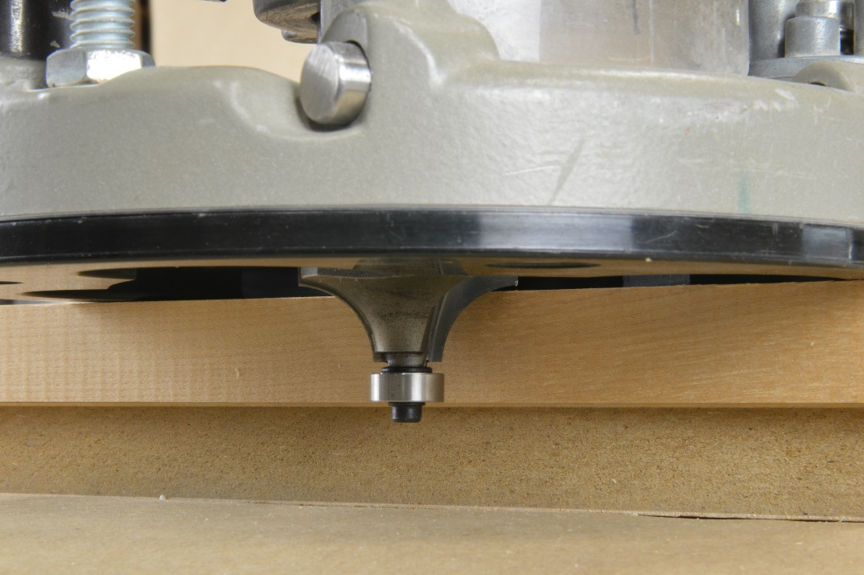
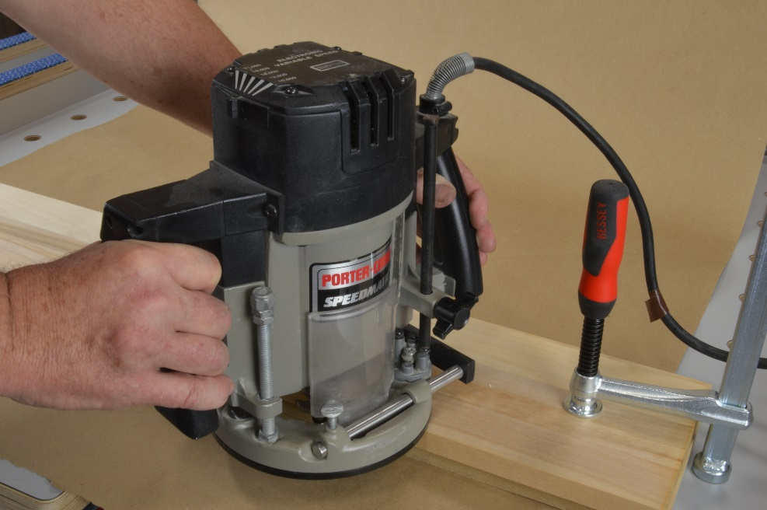
Shaping an Edge with a Router
• Clamp the board to the bench.
• Install a bit and make sure the bench surface does not interfere with the pilot bearing.
A spacer may be necessary so that the screw will not hit the table.
Notes:
Work must be securely clamped while shaping. Beware when routing edge profiles that the cutter does not extend below the stock and cause damage to the table.

Slide 22
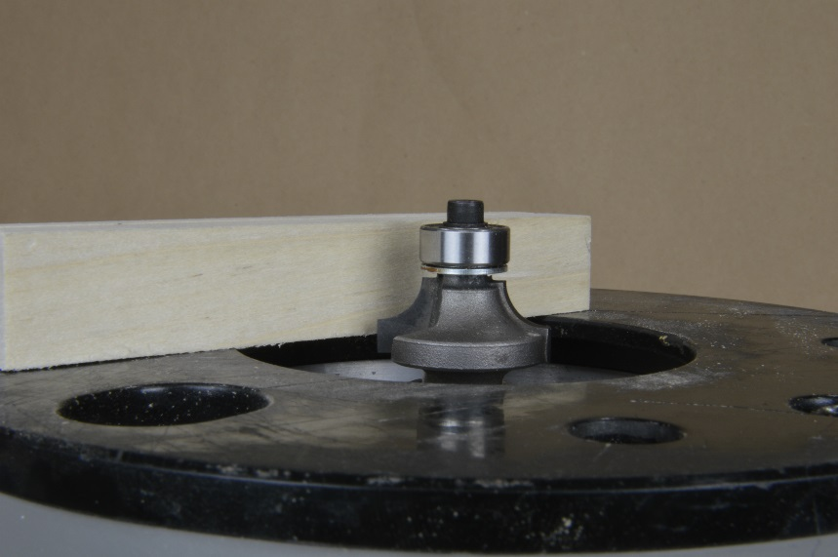
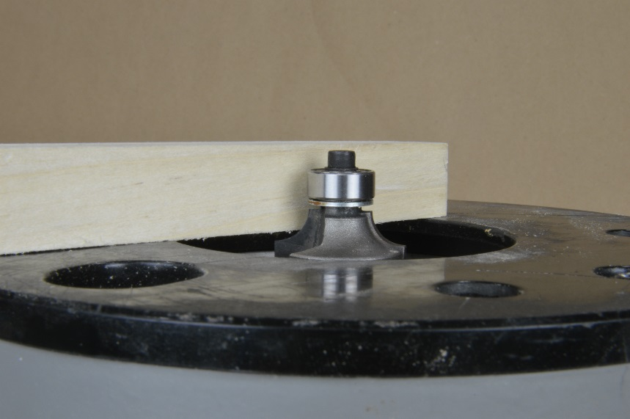
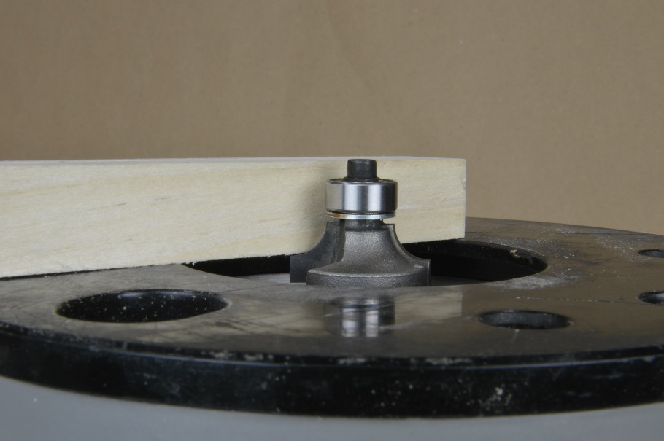
Edge Shaping, continued
The round-over bit is set too high.
The round-over bit is set too low.
The round-over bit is set correctly.
Notes:
To shape an edge, you must first adjust the depth of cut. Use a test piece to check the setting. Never turn the router on when the bit is touching the wood. Allow the motor to come to full speed before cutting. Larger diameter bits can cause the operator to lose control of the router on startup. Be prepared to resist this force.

Slide 23
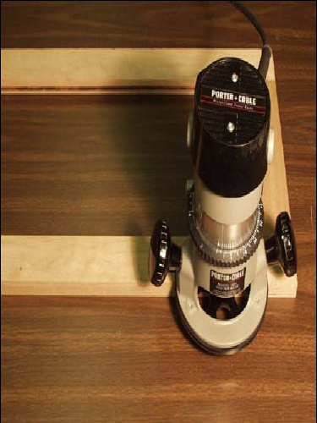
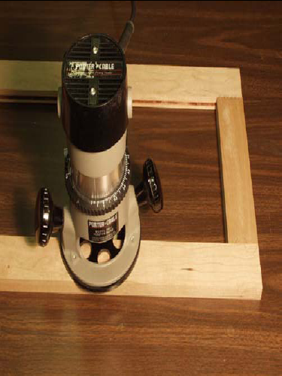
Climb-Cutting
Outside-Counter-Clockwise
Inside-Clockwise
Notes:
If the router feels like “it wants to run away from you”, you are probably climb-cutting. This is only controllable with very small bits. When routing an outside edge, rout counter-clockwise (Left to Right). When routing an inside edge, rout clockwise.

Slide 24
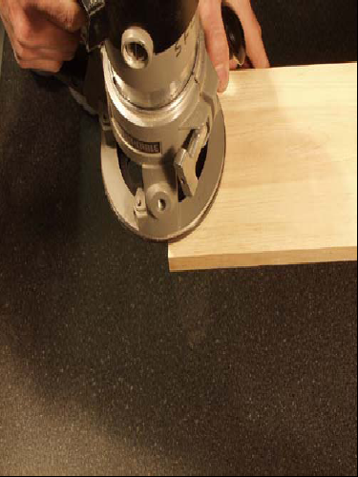
Splintering
1
2
Point where tear-out will occur
Notes:
A splintered edge is caused by the bit pushing the wood-grain apart at the end of a cut. To avoid splintering, first cut across the grain, and then with-the-grain. Routing this direction, across-the-grain, will cause splintering at the end of a cut. This can be avoided by using a sacrificial block, or by climb-cutting at the corner. Care must be taken when climb cutting, especially if your using large diameter bits.

Slide 25
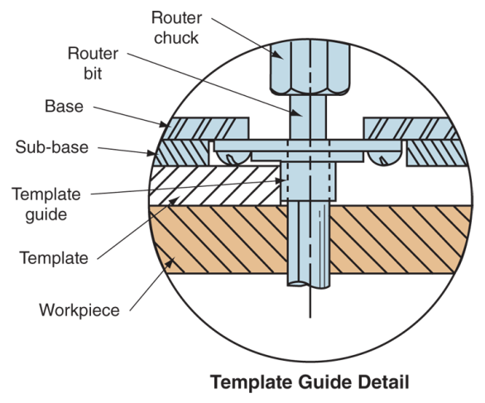
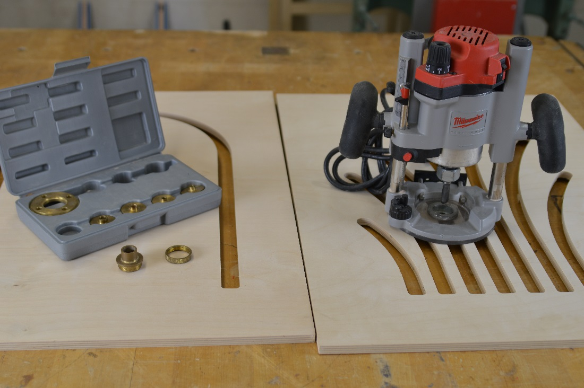
Template Guides
Notes:
It is impossible to make precise cuts with a router when using bits without bearings. To control the cut on bits without bearings, you can use a template guide with a pattern. A template guide which provides clearance for the bit is installed in the base of the router. The guide will follow the edge of a precut pattern.

Slide 26
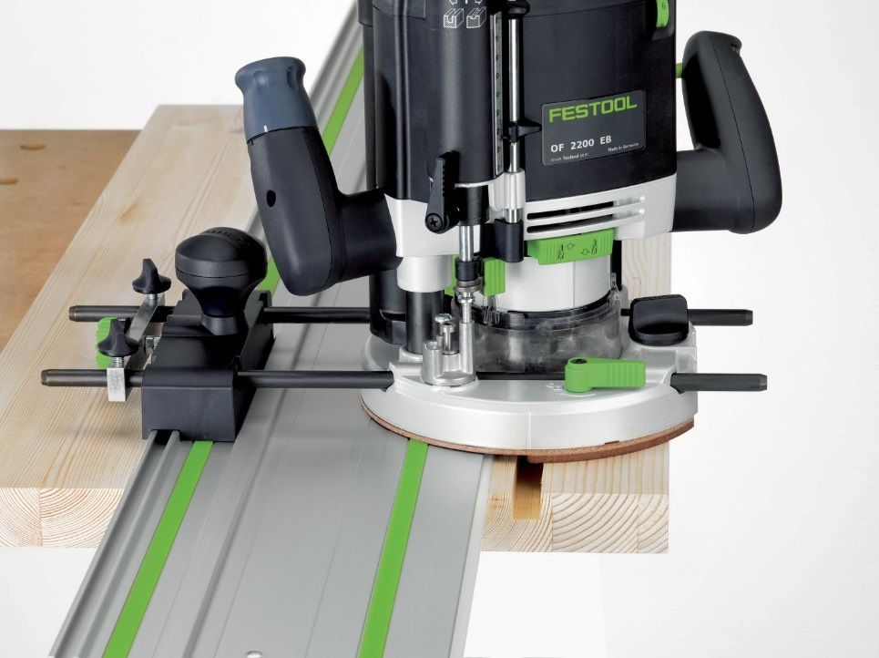
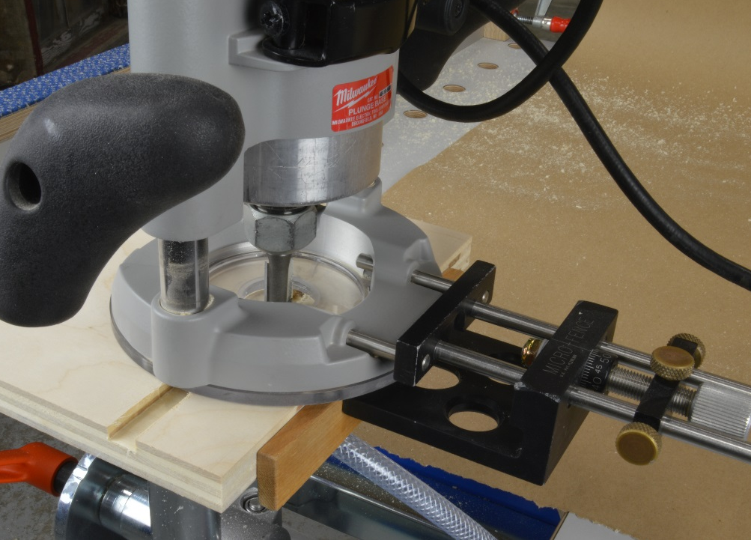
Edge Guides
Notes:
Another way to control the cut is to use an edge guide. OEM guides are available, as well as a number of aftermarket edge guides which allow for precise adjustments for cutting rabbets, dados, circles and ellipses.

Slide 27
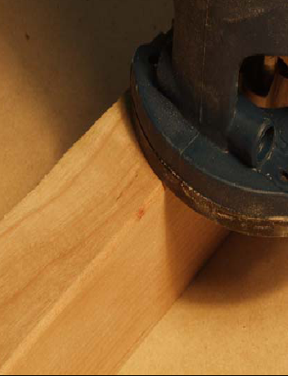
Feed Rate
Burn Mark from
Irregular Feed
Rate
Notes:
Keep a constant feed rate. Each time a cut is stopped there is a chance of causing a burn or gouge. Feed rate is determined by a number of factors, including: bit size and sharpness, depth-of-cut, hardness of material, grain-direction and horsepower.
The larger the bit or harder the material, the slower the feed-rate. If more material is being removed, the lower the feed rate. Extremely large bits require slower RPM’s, and should only be used on routers equipped with speed adjustment.

Slide 28
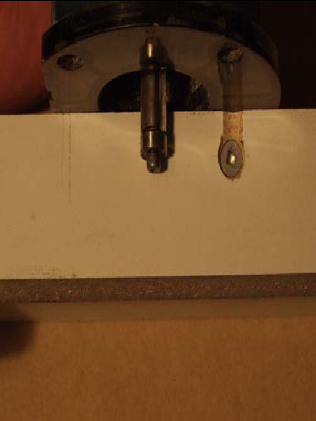
Bearing Surface
Top View of Gouge Mark
Screw Hole that Bearing will fall into, resulting in a gouged surface
Notes:
The work-piece must be thick enough to accept the cutter and the pilot bearing. There must be enough edge for the pilot bearing to run along. The bearing will faithfully follow any bumps or crevices, so make sure the edge is clean and smooth.

Slide 29
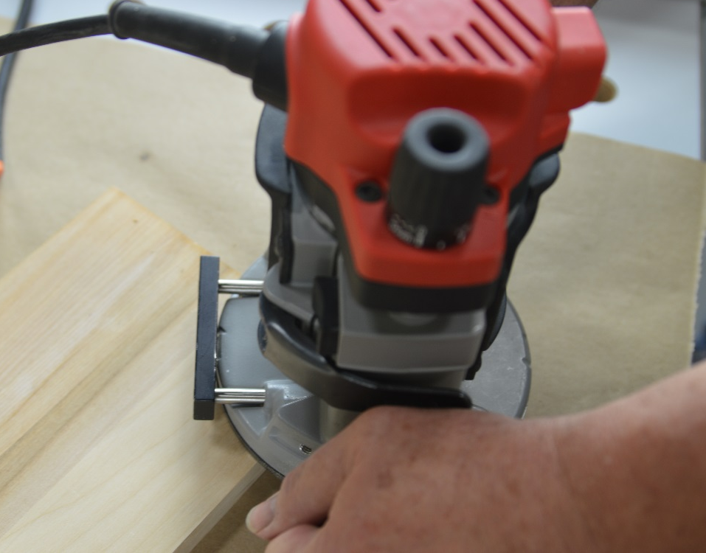
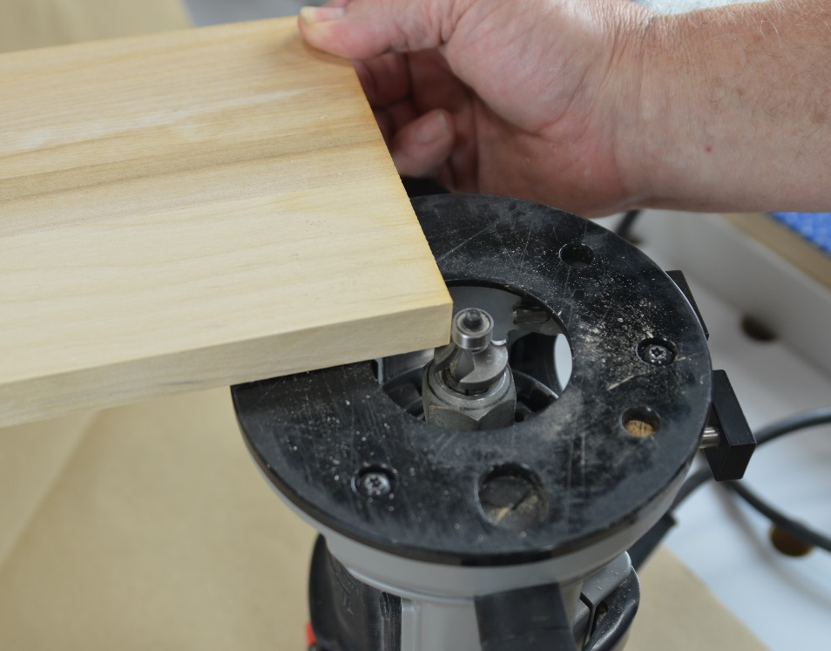
Turning Corners
Only 25% of the router base is
supported at the corner.
Bottom View of the Router Base as supported at the corner.
Notes:
The router base is unstable when turning corners, as only 25% of the base is actually supported. Throughout the cut, hold the router firmly and press the base to the wood where it contacts the surface.

Slide 30
Listen to Your Router
Notes:
It’s hard to estimate how much stress a cut will put on a bit. Develop a sense for this by listening to how the router sounds. If it chatters, screeches, smokes or is ‘struggling’, try slowing the feed-rate, decreasing the depth-of-cut, and/or checking the sharpness of the bit.

Slide 31
Work Safe
• Always use eye and hearing protection and a dust mask. Chips are expelled at high rates. Prolonged use can damage hearing.
• Always make a test cut on a scrap piece.
• Always keep hands and cords clear of the spinning bit.
• Always secure loose clothing and long hair.
• Always know where the ON/OFF switch is.
• Always check that the router is OFF before plugging it in.
• Always unplug the router when changing bits.
• Always use both hands.
• Always make sure bits are clean and sharp with at least 80% of the shank secured in the collet.
• Always clamp the board securely to the workbench.
• Never start the router with the bit in contact with the wood.
• Never set the router down until it has come to a full stop.
Notes:
When using a router, you should…

Slide 32
Acknowledgements
Cabinetmaking
Some of the materials in this presentation were provided by Central Oregon Community College.

