Slide 1
Notes on Evaluating Sanding
Exercise 5.2

Slide 2
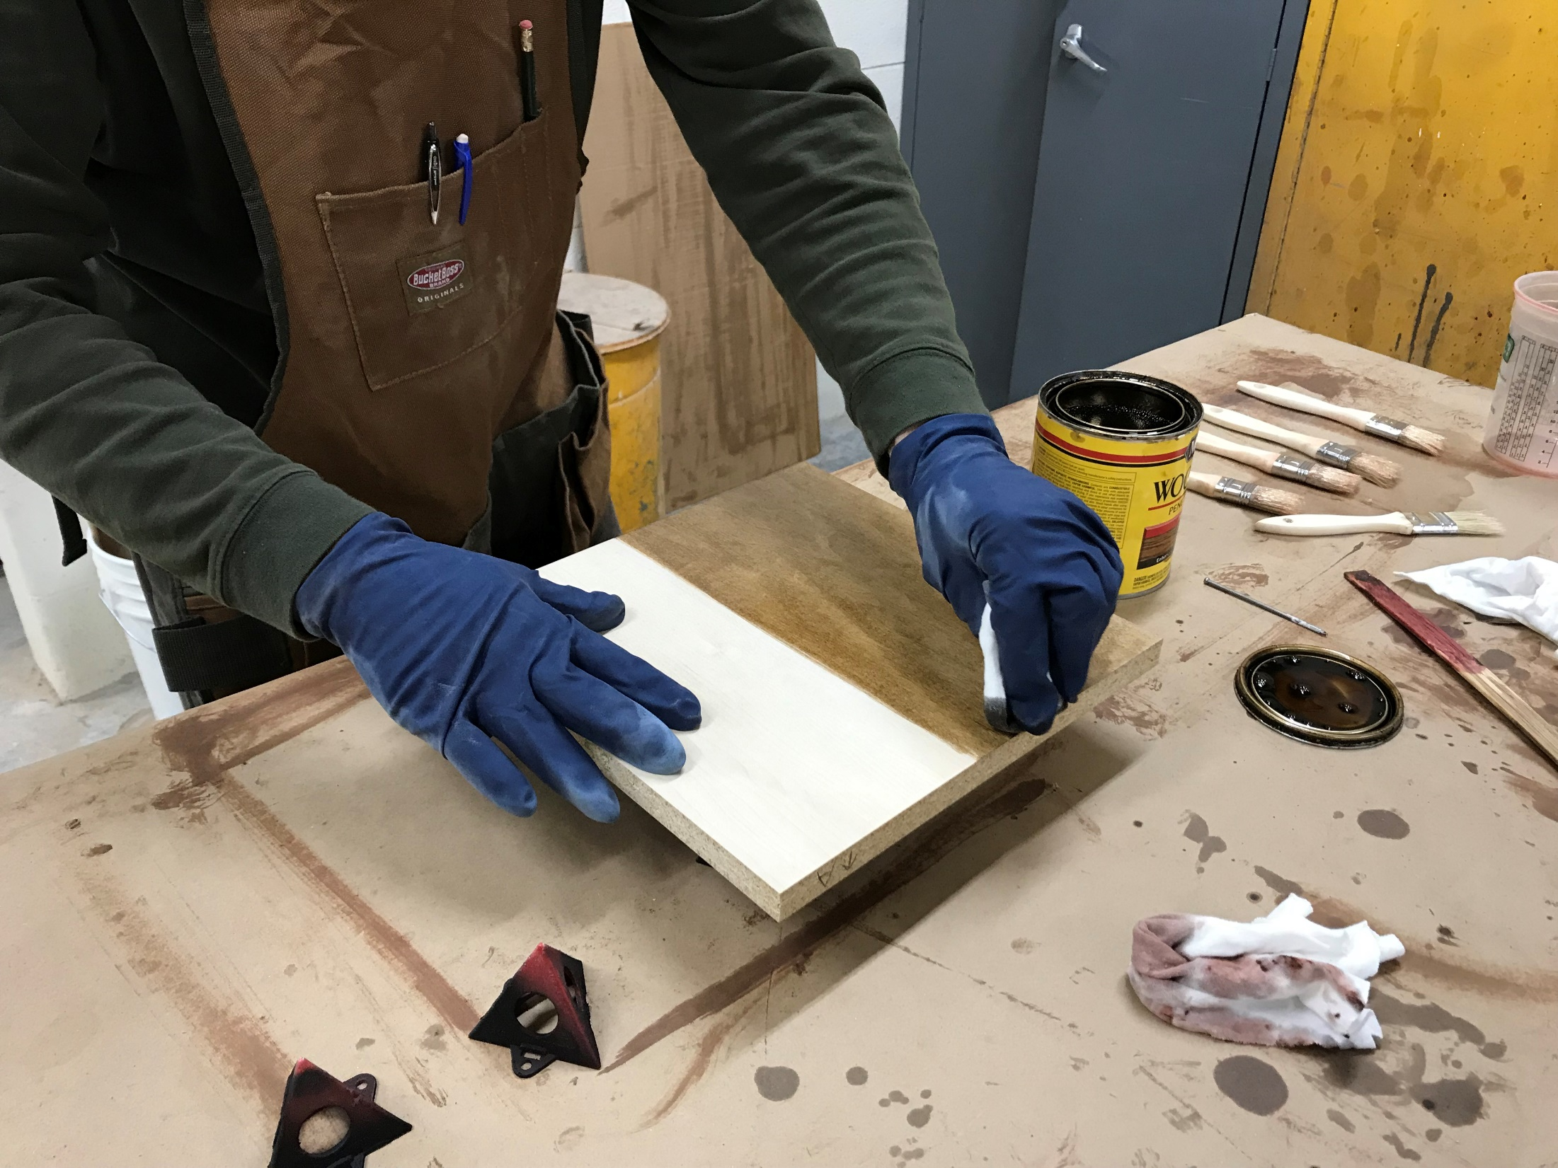
Add a coat of stain to your ½ of each face of your panel – this will make any defects appear more readily.
Notes:
Add a coat of stain to your ½ of each face of your panel – this will make any defects appear more readily.

Slide 3
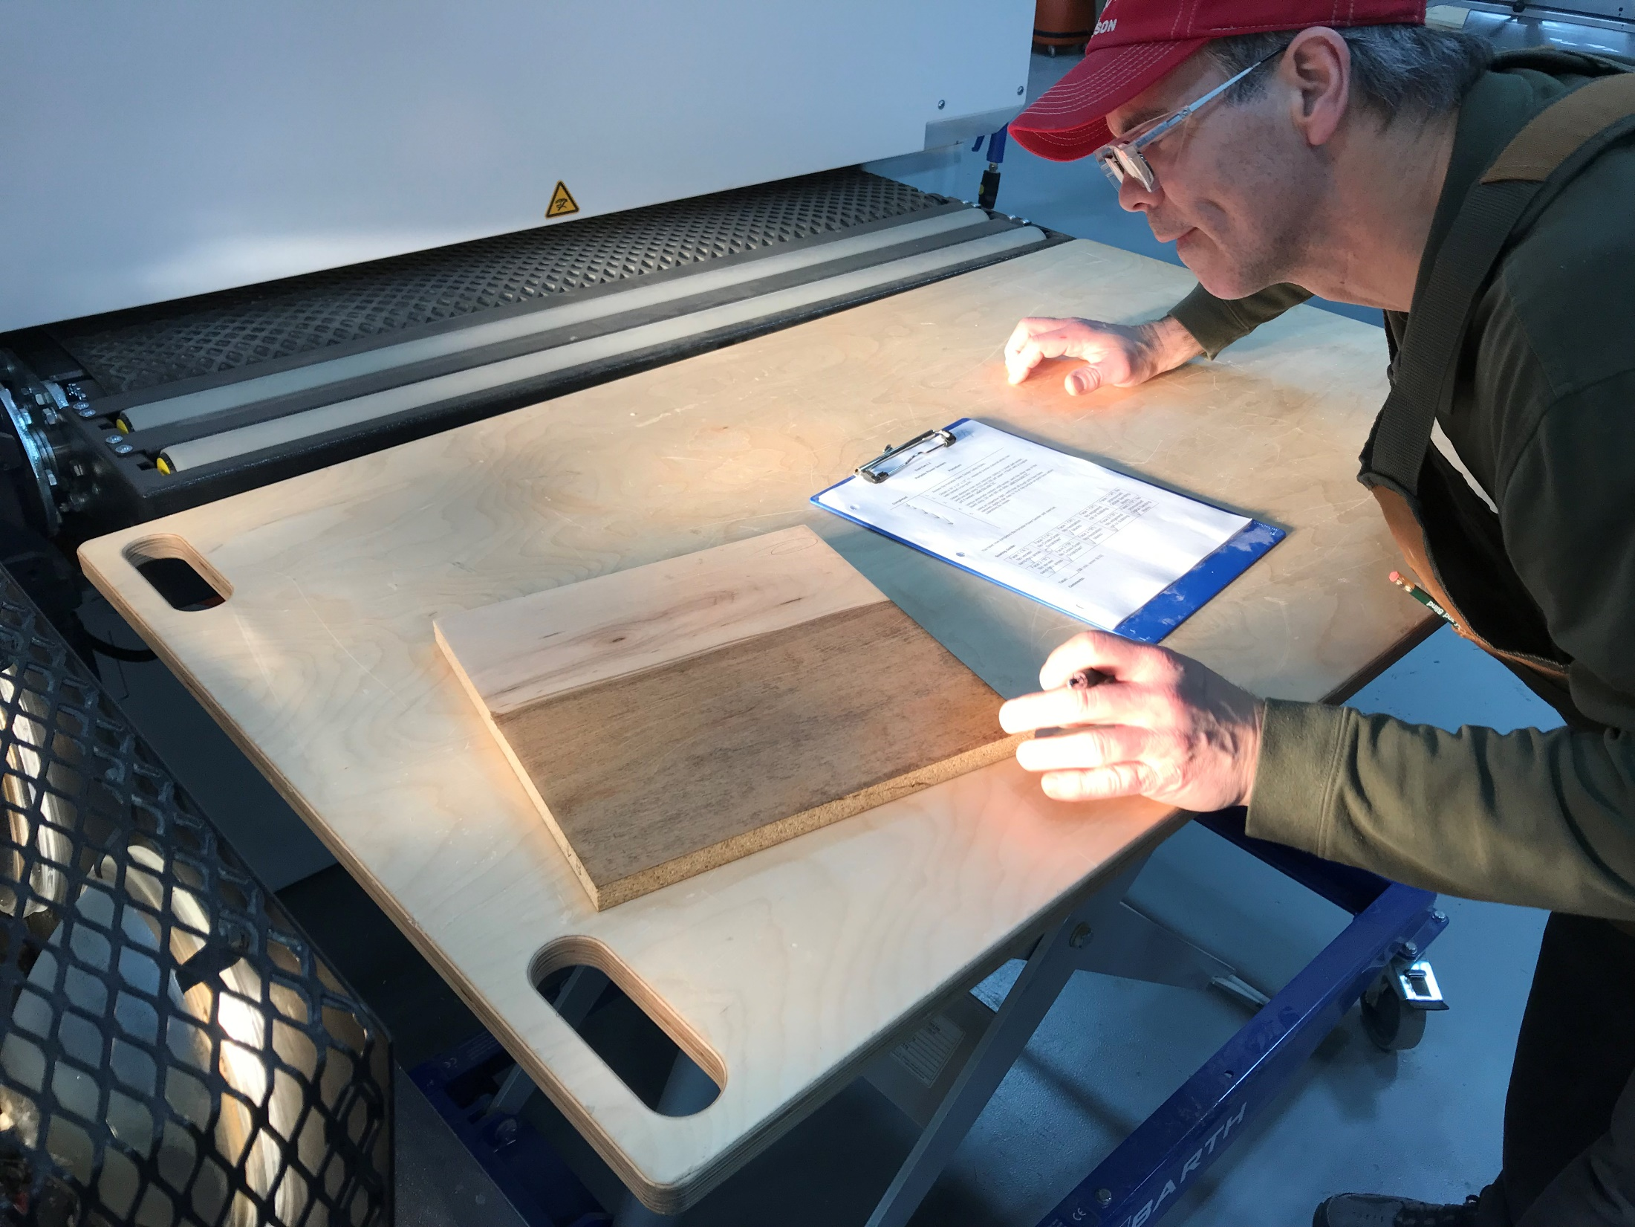
Use an inspection light, or a light source from a low angle to view defects.
Notes:
Use an inspection light, or a light source from a low angle to view defects.

Slide 4
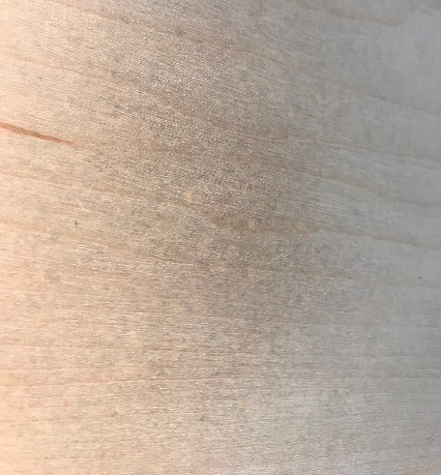
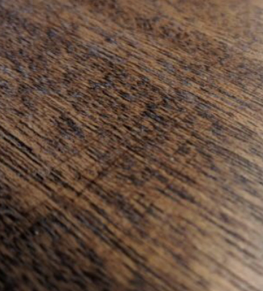
Grading
Mark your faces “A” and “B”. Evaluate each based on the criteria below:
Face 1 ("A"): No apparent sand through (ghosting) of veneer | Face 1 ("A"): No Cross-Grain Scratches | Face 1 ("A"): Sanding marks are consistent and directional with the grain | Face 1 ("A"): No edge/end roll or dubbing | Face 1 ("A"): No pronounced Orbital Sanding Marks

